Slide 1





Introduction To Python Programming

Slide 2

Hello!
I am Eslam Ahmed
I am a software engineer.
You can find me at jeksogsa@gmail.com

Slide 3

Hello!
I am Eman Ehab
I am a ML research engineer.
You can find me at emanehab.ieee@gmail.com

Slide 4
Introduction to Python programming Course Outline
Intro to Computer Science
Environment Setup (Anaconda)
Command Line
Conda & pip package managers
Jupyter Notebook
Input & Output
Variables
Data types
Numbers & Math
Boolean & Comparison and Logic
Strings
Lists
Tuples
Sets
Dictionaries
File Handling
If Conditions
For Loops
Built-in functions & Operators (zip, enumerate, range, …)
List Comprehensions
Functions
Lambda Expressions
Map, Filter, Reduce
Variables Scope
Modules & Packages

Slide 5
Introduction to Python programming Course Outline
Intro to Computer Science
Environment Setup (Anaconda)
Command Line
Conda & pip package managers
Jupyter Notebook
Input & Output
Variables
Data types
Numbers & Math
Boolean & Comparison and Logic
Strings
Lists
Tuples
Sets
Dictionaries
File Handling
If Conditions
For Loops
Built-in functions & Operators (zip, enumerate, range, …)
List Comprehensions
Functions
Lambda Expressions
Map, Filter, Reduce
Variables Scope
Modules & Packages

Slide 6
Intro to Computer Science
How Computers Work
Decimal & Binary numbering systems
How computer stores Words (ASCII)
How computer stores Images
How computer stores Videos
How computer stores Audio
Technology Tree
Why python

Slide 7
Intro to Computer Science
How Computers Work
Decimal & Binary numbering systems
How computer stores Words (ASCII)
How computer stores Images
How computer stores Videos
How computer stores Audio
Technology Tree
Why python

Slide 8
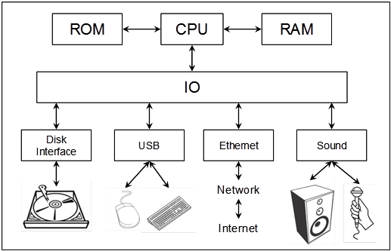



How Computers Work

Slide 9
Intro to Computer Science
How Computers Work
Decimal & Binary numbering systems
How computer stores Words (ASCII)
How computer stores Images
How computer stores Videos
How computer stores Audio
Technology Tree
Why python

Slide 10
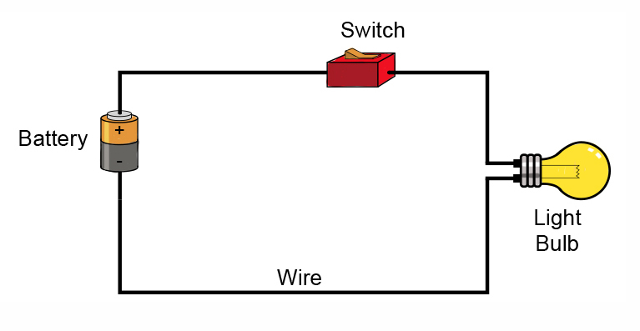
Decimal & Binary numbering systems

Slide 11
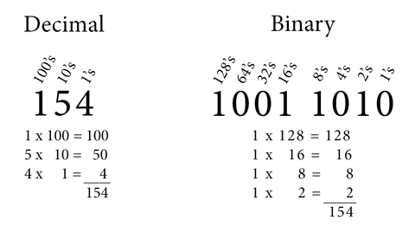
Decimal & Binary numbering systems

Slide 12
Intro to Computer Science
How Computers Work
Decimal & Binary numbering systems
How computer stores Words (ASCII)
How computer stores Images
How computer stores Videos
How computer stores Audio
Technology Tree
Why python

Slide 13
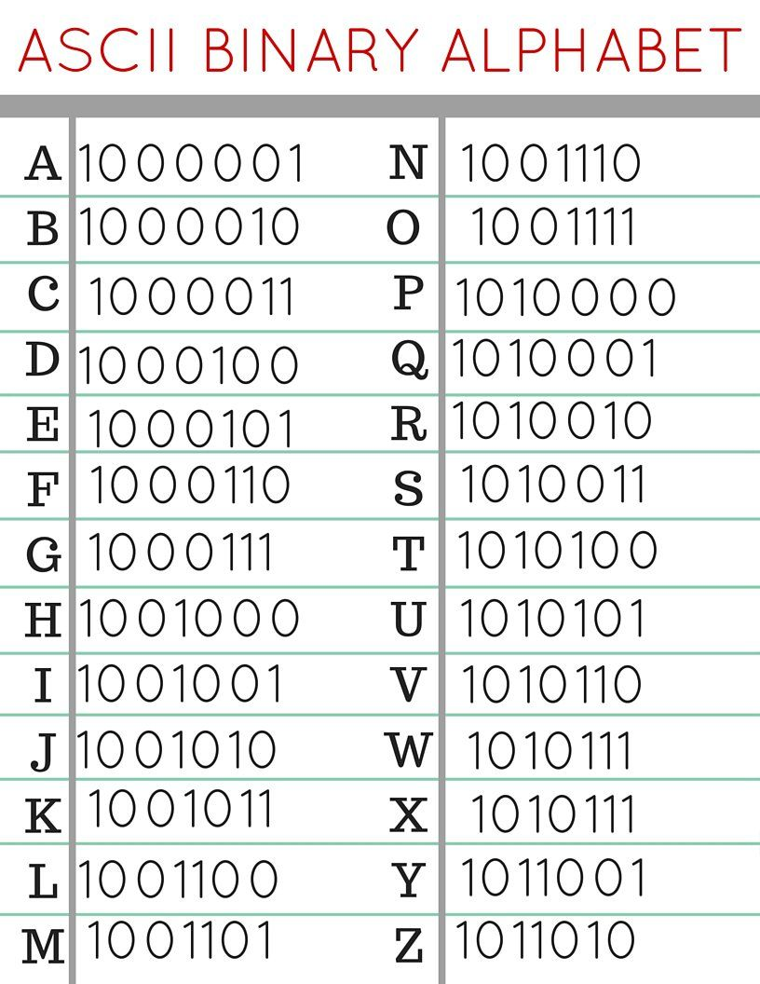
How computer stores Words (ASCII)
Full Table
http://www.asciitable.com/

Slide 14
Intro to Computer Science
How Computers Work
Decimal & Binary numbering systems
How computer stores Words (ASCII)
How computer stores Images
How computer stores Videos
How computer stores Audio
Technology Tree
Why python

Slide 15
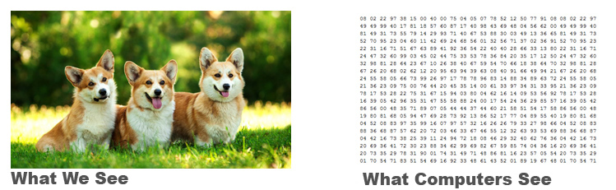
How computer stores Images

Slide 16

How computer stores Images
Pixels
Every pixel is one color
Height
Width

Slide 17

How computer stores Images
RGB Digital Images
We can generate any color by mixing
(red, green, blue) colors with different ratios.

Slide 18
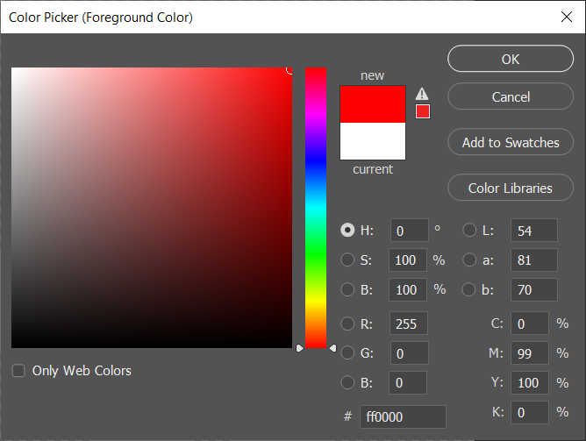
How computer stores Images (Red)

Slide 19
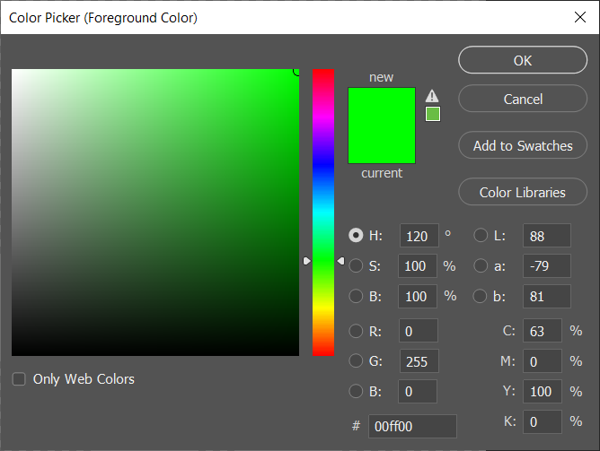
How computer stores Images (Green)

Slide 20
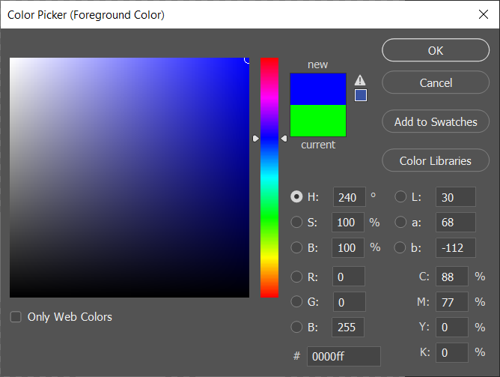
How computer stores Images (Blue)

Slide 21
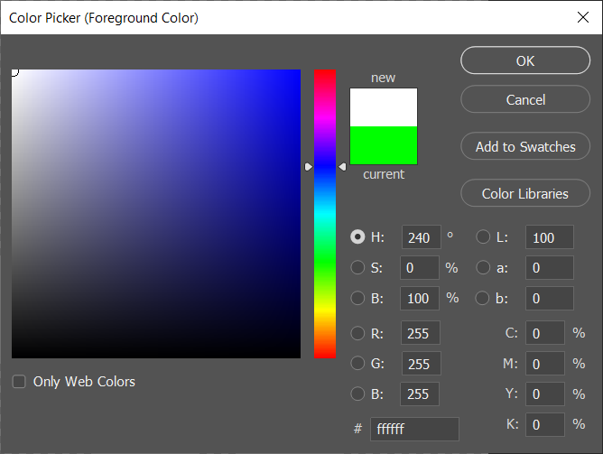
How computer stores Images (White)

Slide 22

How computer stores Images (Black)

Slide 23
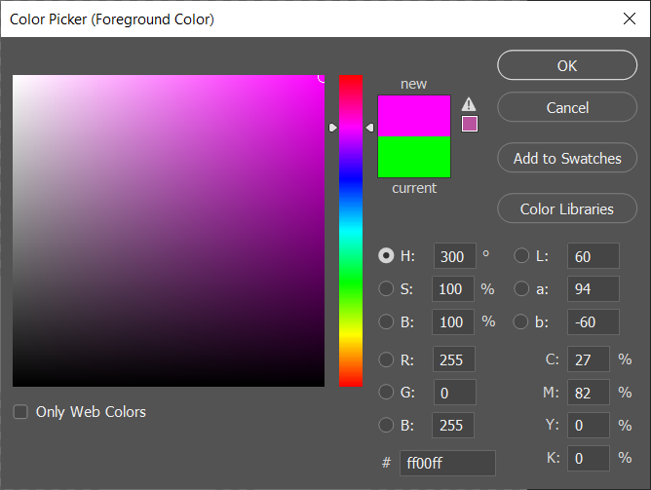
How computer stores Images (Pink)

Slide 24
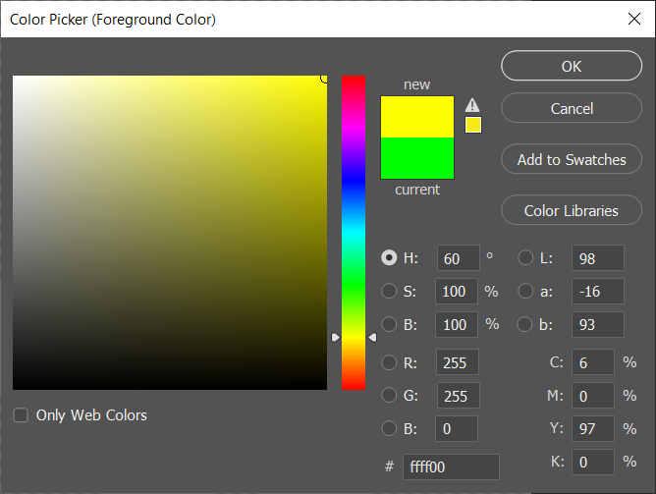
How computer stores Images (Yellow)

Slide 25
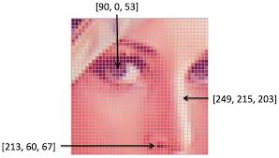
How computer stores Images
Resolution: 100x100
Width : 100 pixels
Height: 100 pixels

Slide 26
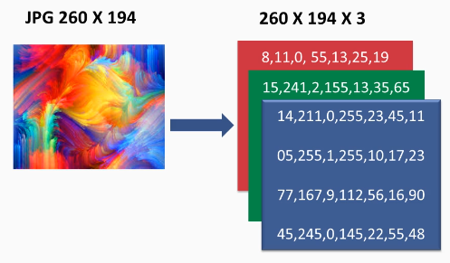
How computer stores Images

Slide 27
Intro to Computer Science
How Computers Work
Decimal & Binary numbering systems
How computer stores Words (ASCII)
How computer stores Images
How computer stores Videos
How computer stores Audio
Technology Tree
Why python

Slide 28
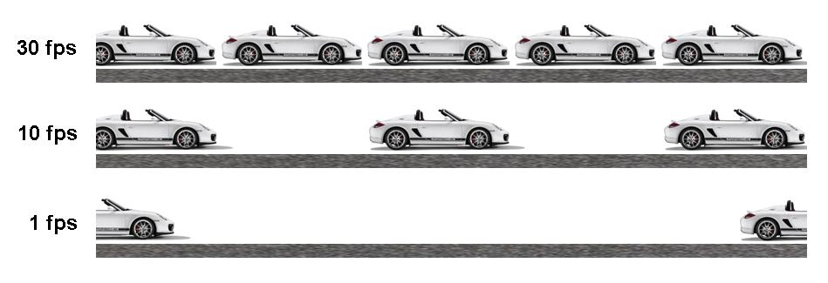
How computer stores Videos

Slide 29
Intro to Computer Science
How Computers Work
Decimal & Binary numbering systems
How computer stores Words (ASCII)
How computer stores Images
How computer stores Videos
How computer stores Audio
Technology Tree
Why python

Slide 30
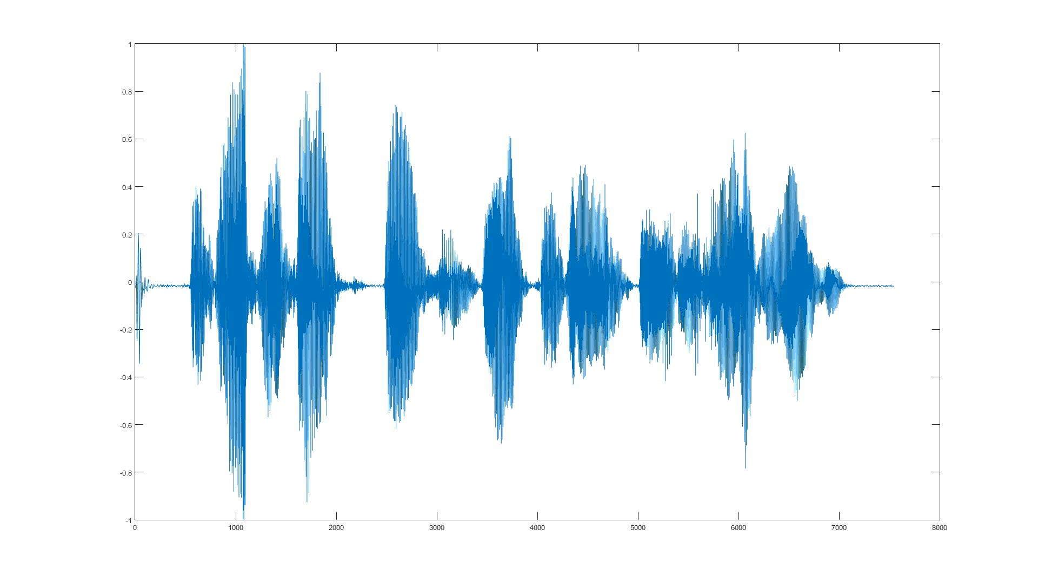
How computer stores Audio

Slide 31
Intro to Computer Science
How Computers Work
Decimal & Binary numbering systems
How computer stores Words (ASCII)
How computer stores Images
How computer stores Videos
How computer stores Audio
Technology Tree
Why python

Slide 32

Programming ?!
Just writing code for executing some sequential instructions to perform
various tasks.
Computers are FAST but DUMB, they need to know what to do.

Slide 33
Technology Tree
Embedded Systems
Operating Systems
Desktop Applications
Web Applications
Mobile Applications
Database Systems
Networking & Server administration
Internet of Things
Game Development
AR / VR
Compression
Encryption
Security & Ethical Hacking
Machine & Deep Learning
Data Science
Computer Vision
Speech Processing
Natural Language Processing
Autonomous
Blockchain
Big Data
Computer Graphics
Compiler Design
…

Slide 34
Intro to Computer Science
How Computers Work
Decimal & Binary numbering systems
How computer stores Words (ASCII)
How computer stores Images
How computer stores Videos
How computer stores Audio
Technology Tree
Why python

Slide 35
Why Python ?!
>_ Easy to Learn, Read, Maintain.
>_ Very Big Community so you will find a lot of Libraries to use.

Slide 36
Python 2 vs 3 ?!

Slide 37
Introduction to Python programming Course Outline
Intro to Computer Science
Environment Setup (Anaconda)
Command Line
Conda & pip package managers
Jupyter Notebook
Input & Output
Variables
Data types
Numbers & Math
Boolean & Comparison and Logic
Strings
Lists
Tuples
Sets
Dictionaries
File Handling
If Conditions
For Loops
Built-in functions & Operators (zip, enumerate, range, …)
List Comprehensions
Functions
Lambda Expressions
Map, Filter, Reduce
Variables Scope
Modules & Packages

Slide 38

Awesome Python Distribution. Free and open-source distribution of the Python and R programming languages for scientific computing (data science, machine learning applications) . Anaconda distribution includes data-science packages suitable for Windows, Linux, and macOS. https://www.anaconda.com
ANACONDA

Slide 39

Awesome Code Editor. https://code.visualstudio.com
Visual Studio Code

Slide 40
Introduction to Python programming Course Outline
Intro to Computer Science
Environment Setup (Anaconda)
Command Line
Conda & pip package managers
Jupyter Notebook
Input & Output
Variables
Data types
Numbers & Math
Boolean & Comparison and Logic
Strings
Lists
Tuples
Sets
Dictionaries
File Handling
If Conditions
For Loops
Built-in functions & Operators (zip, enumerate, range, …)
List Comprehensions
Functions
Lambda Expressions
Map, Filter, Reduce
Variables Scope
Modules & Packages

Slide 41
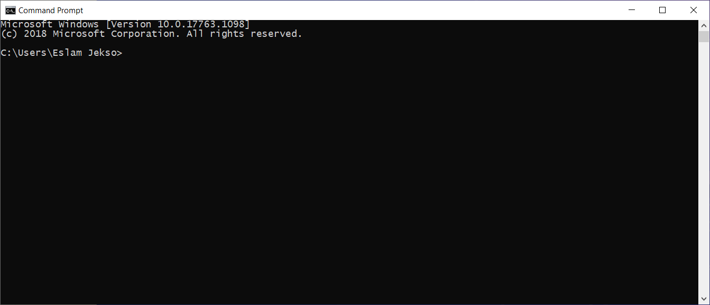
Command Line
>_ cd
>_ dir
>_ copy
>_ del
>_ move
…

Slide 42
Introduction to Python programming Course Outline
Intro to Computer Science
Environment Setup (Anaconda)
Command Line
Conda & pip package managers
Jupyter Notebook
Input & Output
Variables
Data types
Numbers & Math
Boolean & Comparison and Logic
Strings
Lists
Tuples
Sets
Dictionaries
File Handling
If Conditions
For Loops
Built-in functions & Operators (zip, enumerate, range, …)
List Comprehensions
Functions
Lambda Expressions
Map, Filter, Reduce
Variables Scope
Modules & Packages

Slide 43
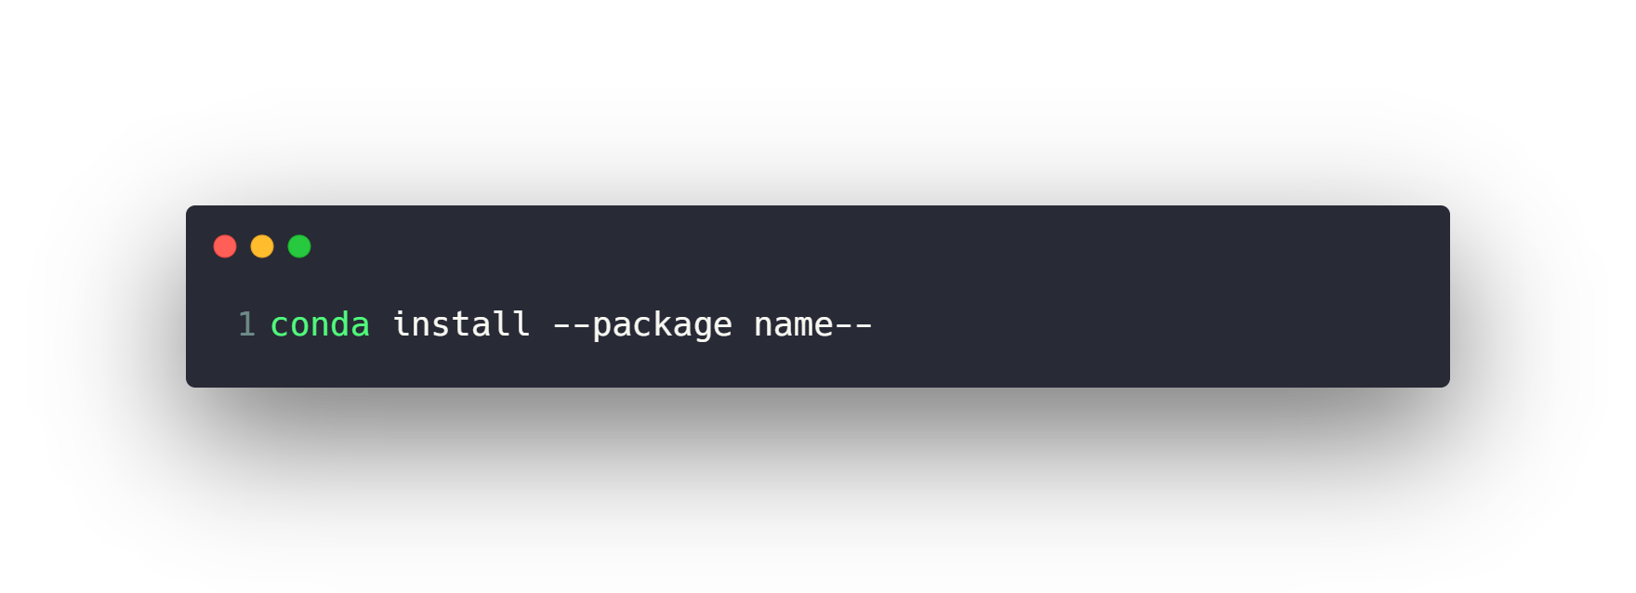
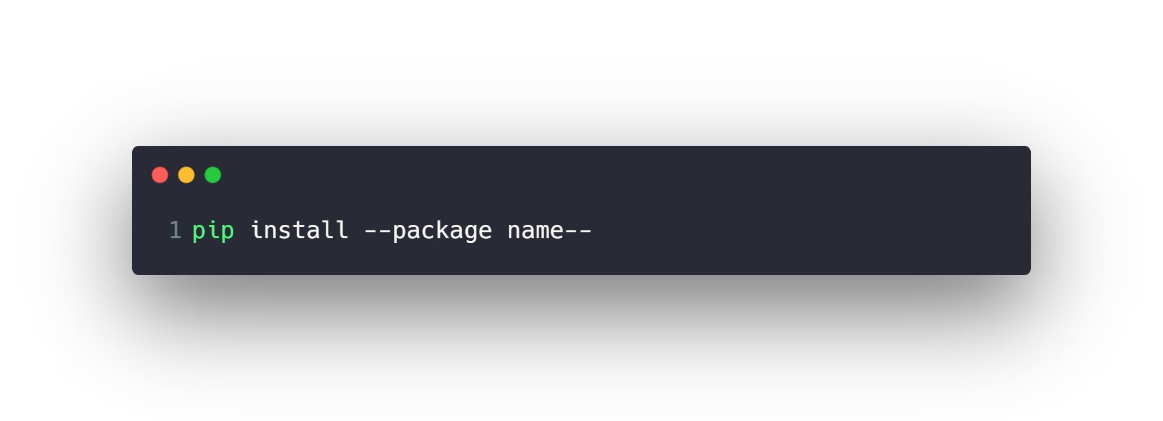
conda & pip package managers
https://anaconda.org/
https://pypi.org/

Slide 44
Introduction to Python programming Course Outline
Intro to Computer Science
Environment Setup (Anaconda)
Command Line
Conda & pip package managers
Jupyter Notebook
Input & Output
Variables
Data types
Numbers & Math
Boolean & Comparison and Logic
Strings
Lists
Tuples
Sets
Dictionaries
File Handling
If Conditions
For Loops
Built-in functions & Operators (zip, enumerate, range, …)
List Comprehensions
Functions
Lambda Expressions
Map, Filter, Reduce
Variables Scope
Modules & Packages

Slide 45
Run Python Script via Command Line
1- Make a .py file
2- Write code & Save it
3- Open cmd
4- >_ python file.py

Slide 46
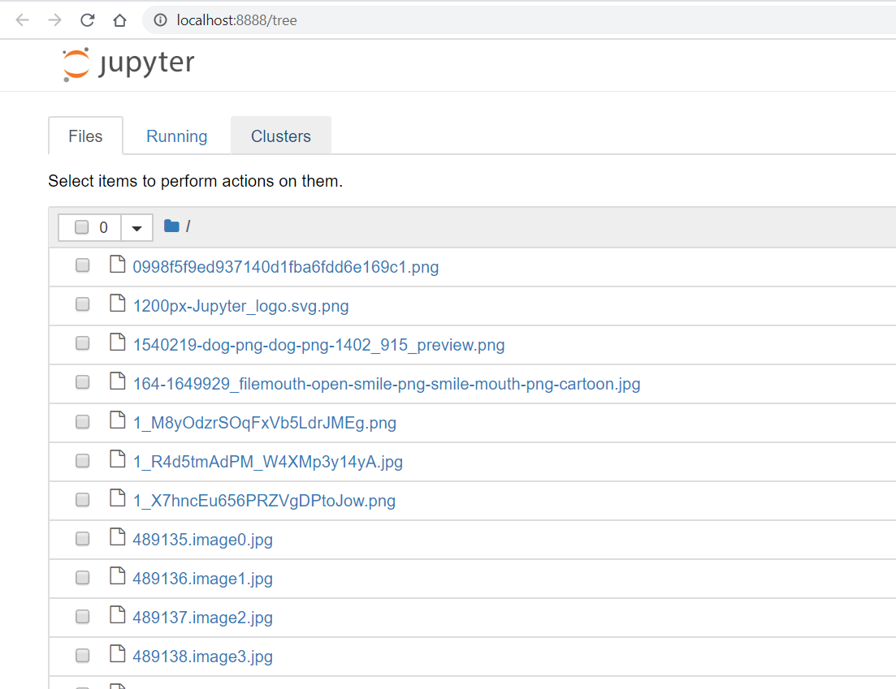
Run Python via Jupyter Notebook
1- Open cmd in a folder
2- >_ jupyter notebook

Slide 47

Jupyter Notebook
Create new .ipynb file
Naming the notebook
Menu buttons (Run, Insert, Delete cells, etc…)
Move Cell up or down
Copy, Paste and Cut Cells
Merge Cells
Saving the notebook for checkpoints
Code and Markdown Cells
Export .py file
Kernel
Use command line in Jupyter using ‘!’ operator

Slide 48
Jupyter Notebook (Shortcuts)
--- > Execute Cell
--- > Execute Cell then go to the next cell
--- > Execute Cell then insert new cell below
--- > Insert Cell Above or Below
--- > Select Cells Above or Below
--- > Copy, Paste and Cut Cells inside Notebook
--- > Copy, Paste and Cut Cells outside Notebook
--- > Delete Cells
--- > Merge Cells
--- > Make Cell type Code or Markdown
--- > Save Notebook
Ctrl + Enter
Shift + Enter
Alt + Enter
A and B
Shift + Up or Down
C and V and X
Ctrl + C or V or X
Double D
Shift + M
Y and M
S
https://www.audiolabs-erlangen.de/resources/MIR/FMP/B/B_Jupyter.html

Slide 49
Questions ?!

Slide 50
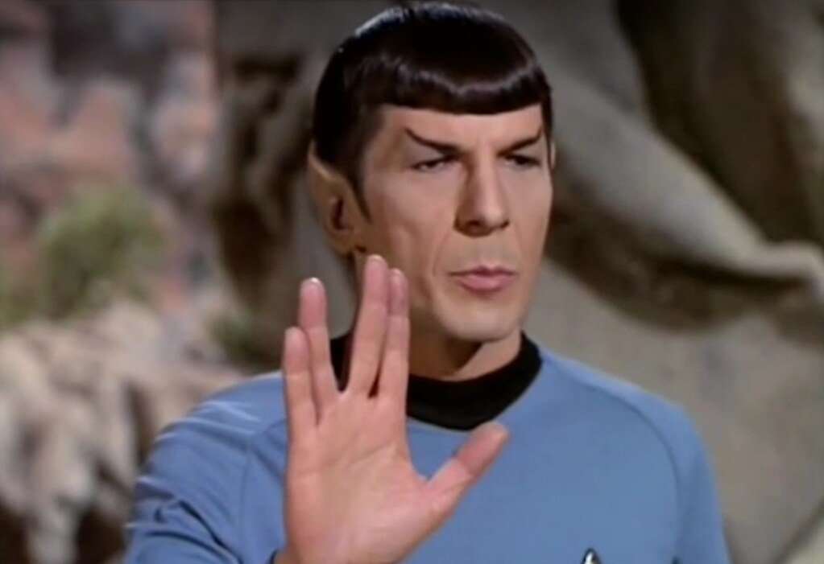
Thanks! >_ Live long and prosper

